Slide 1
EXECUTIVE READOUT
Customer shopping behavior is a loyalty story with a subscription gap
3,900 purchases · customer segments · product signals · growth opportunities

Slide 2
Three signals should shape the next growth plan
01
02
03
Loyalty is strong
Subscriptions are under-penetrated
Discounts do not eliminate spend
3,116 customers are classified as Loyal, while only 83 are New.
27% of customers subscribe; 73% do not.
839 discount users still spent above the average purchase amount.

Slide 3
The analysis combines transaction data with customer and fulfillment signals
DATA FOUNDATION
Transaction, customer, and fulfillment signals
A single analytical base connects behavior, category, shipping, and subscription patterns.
Transaction base
Decision lenses
Data preparation
3,900 purchases across 18 columns and 25 products.
Demographics, category, purchase amount, discounting, shipping, reviews, subscriptions, and frequency.
Review ratings were cleaned using category-level median imputation; cleaned data was loaded into PostgreSQL for SQL analysis.

Slide 4
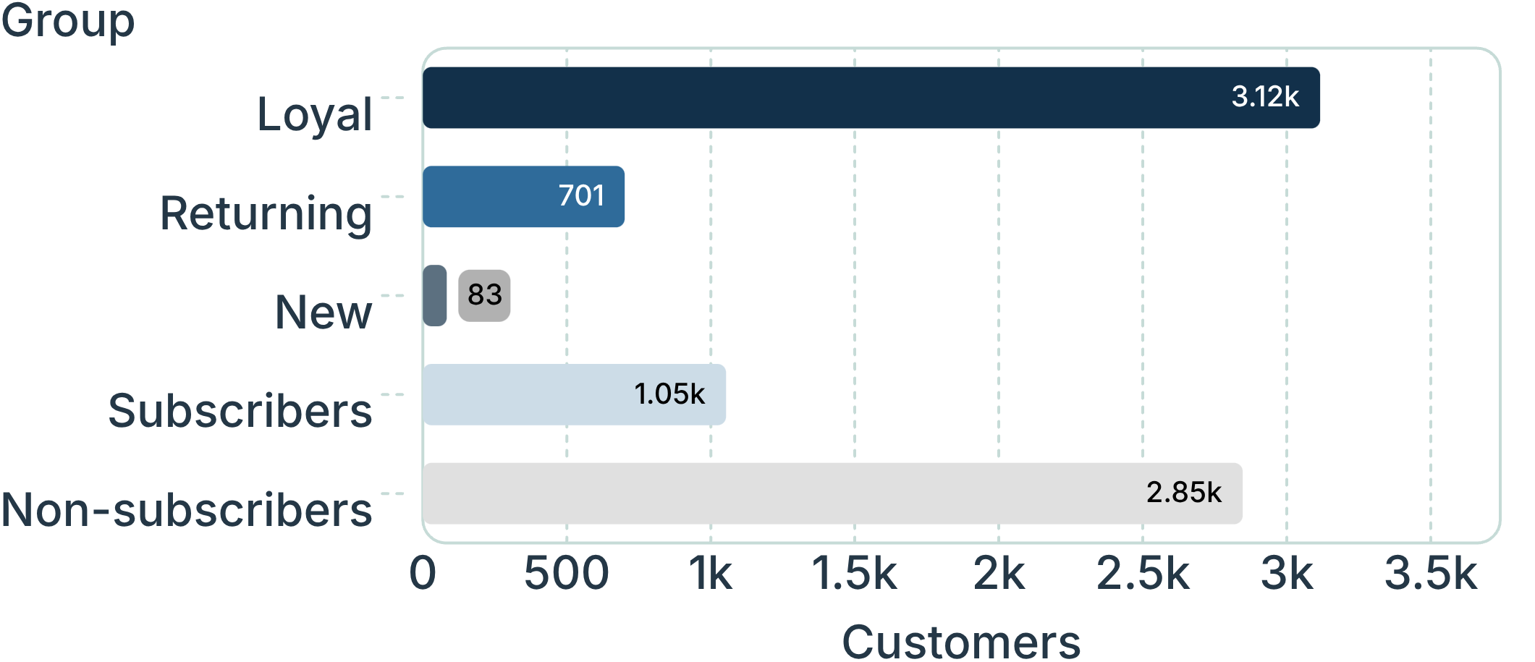
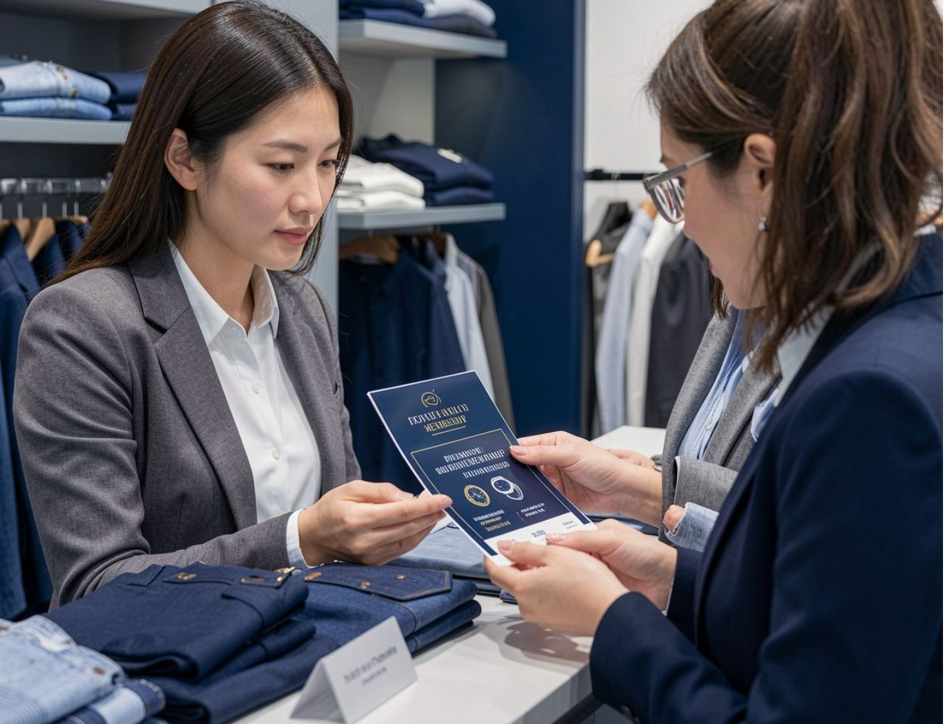
Loyal customers are the foundation; subscriptions are the unlock
Most customers are already repeat buyers, but subscription adoption remains limited. The opportunity is to convert proven behavior into recurring value.
The customer base is dominated by Loyal customers, while subscribers are a minority.
Customer segment and subscription mix · customers

Slide 5
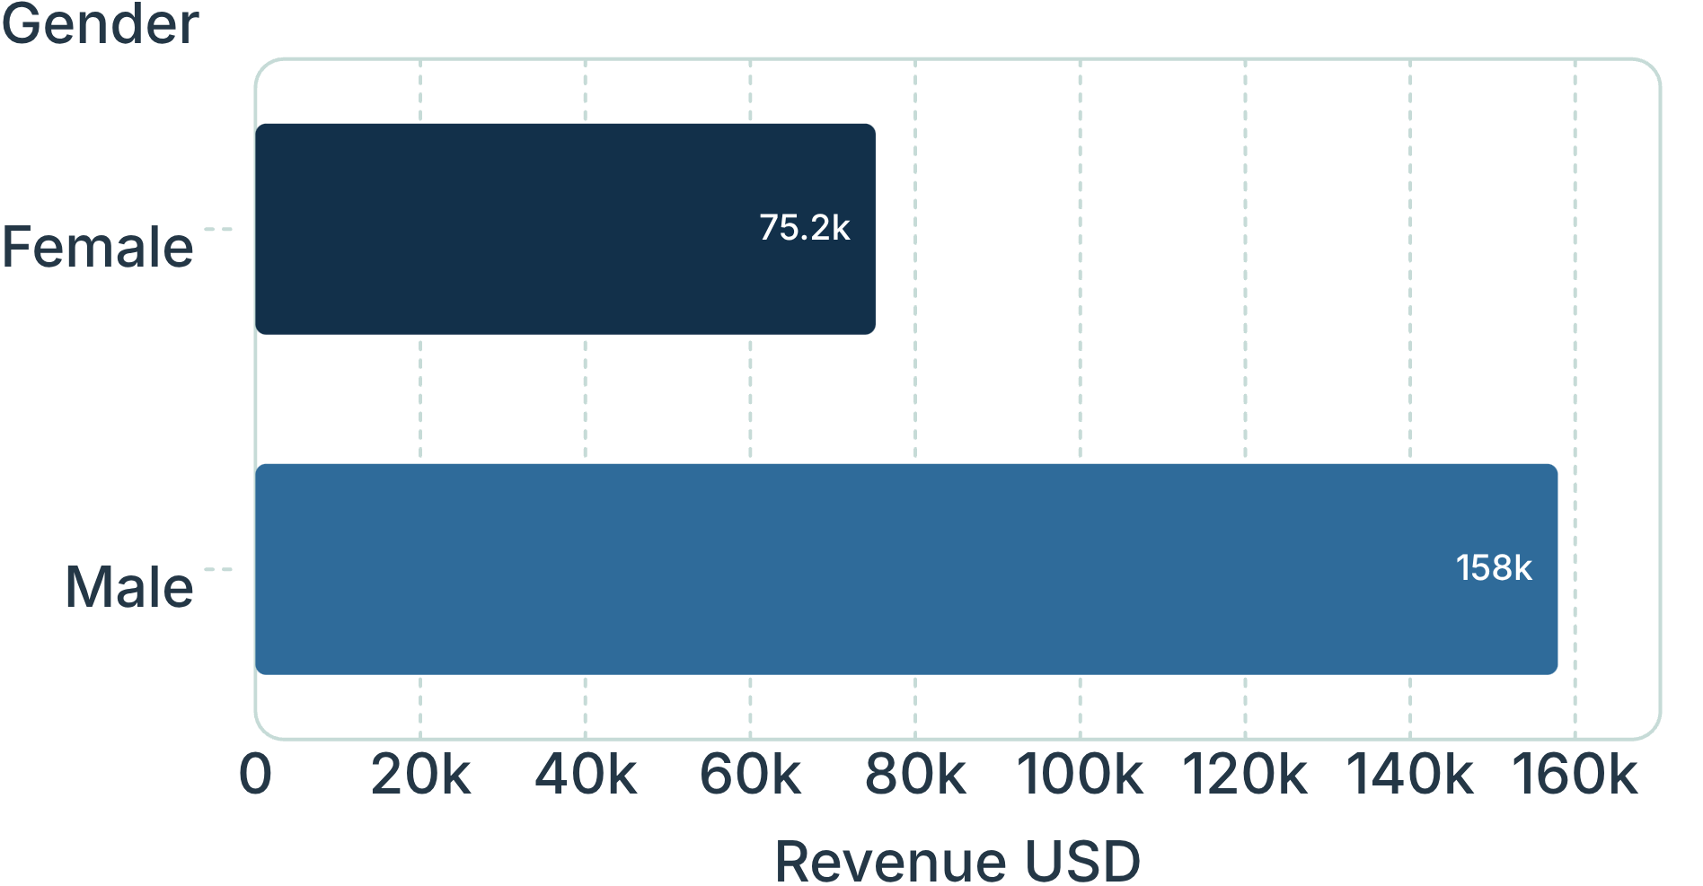
Revenue is concentrated in male customers and clothing
$157,890
Male customers generated the majority of observed revenue.
Clothing leads category revenue at approximately $90K, followed by accessories at approximately $70K.
Use category scale to prioritize merchandising and campaign investment.
Revenue by gender · USD

Slide 6
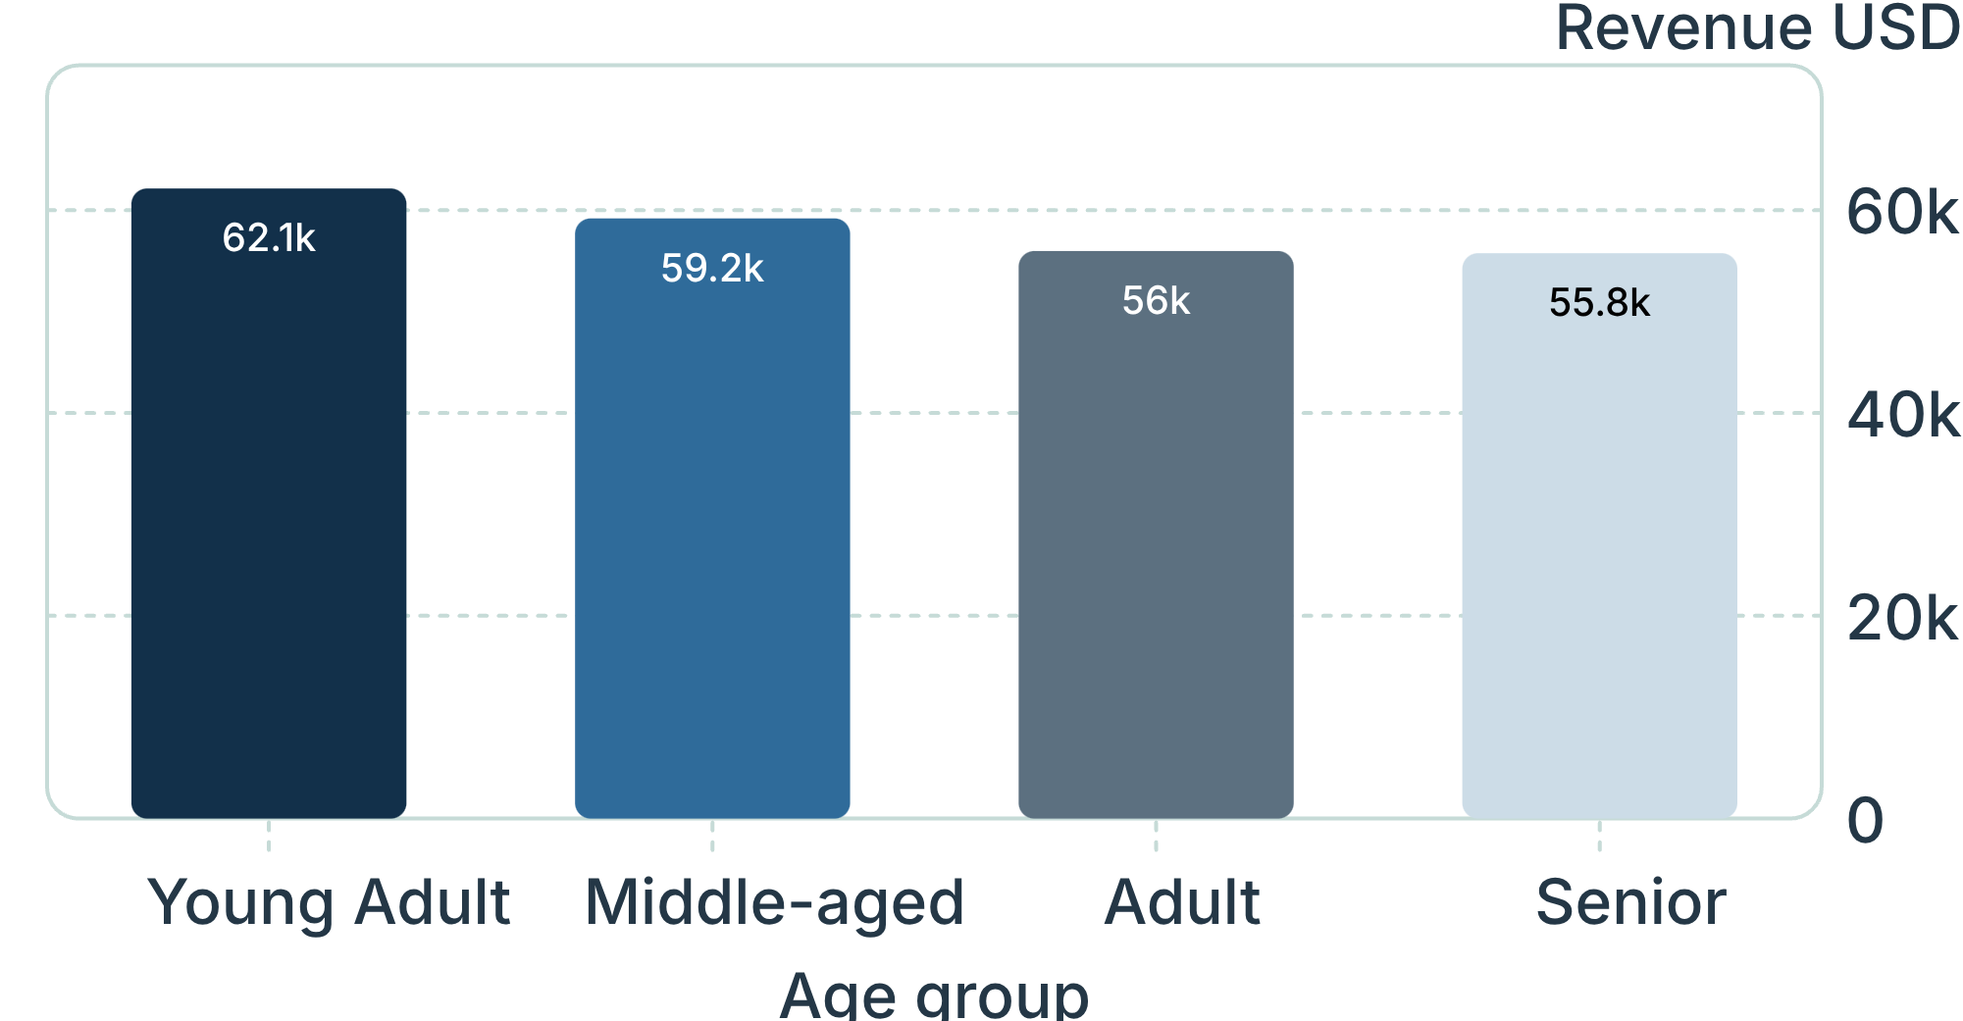
Young adults lead revenue, while express shipping signals higher spend
$60.48
Express-shipping orders averaged more than Standard.
Standard averaged $58.46.
Target convenience-led offers toward higher-value segments and fulfillment moments.
Revenue by age group · USD

Slide 7
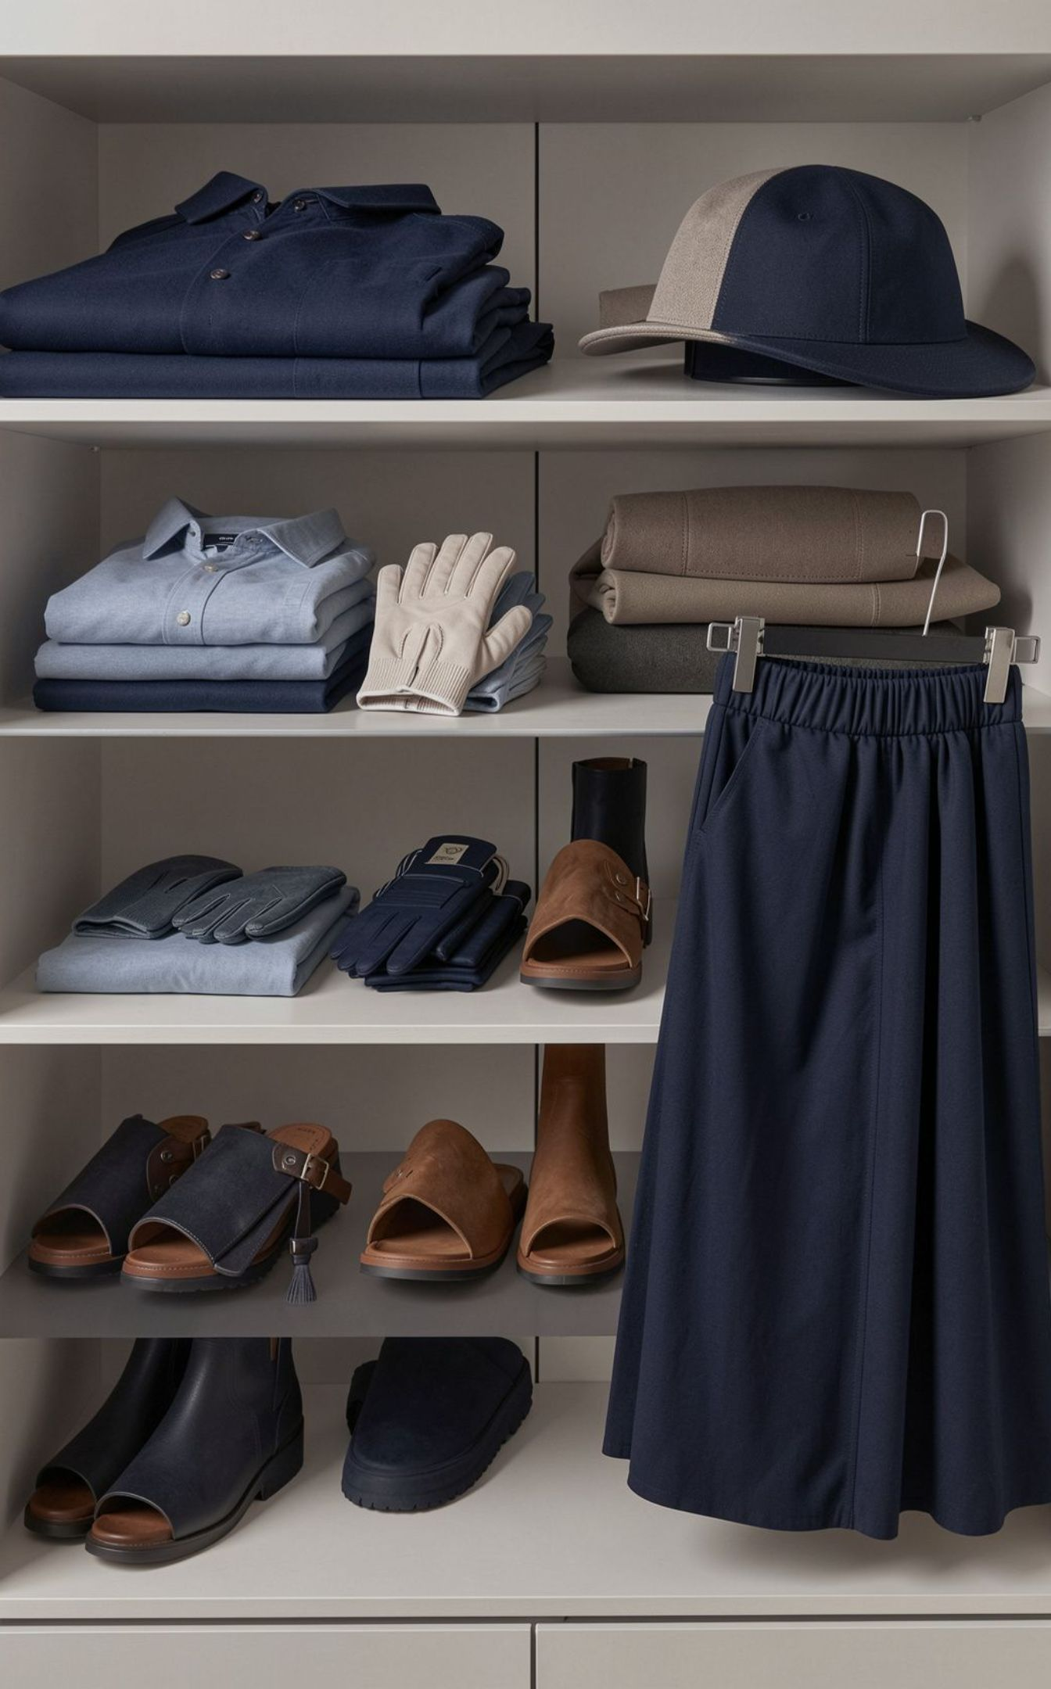
Product signals point to a focused merchandising story
Top-rated products
Category leaders
Gloves 3.86 · Sandals 3.84 · Boots 3.82 · Hat 3.80 · Skirt 3.78
Jewelry in Accessories · Blouse in Clothing · Sandals in Footwear · Jacket in Outerwear
Feature high-rated products in campaigns, then use category leaders as conversion anchors.

Slide 8
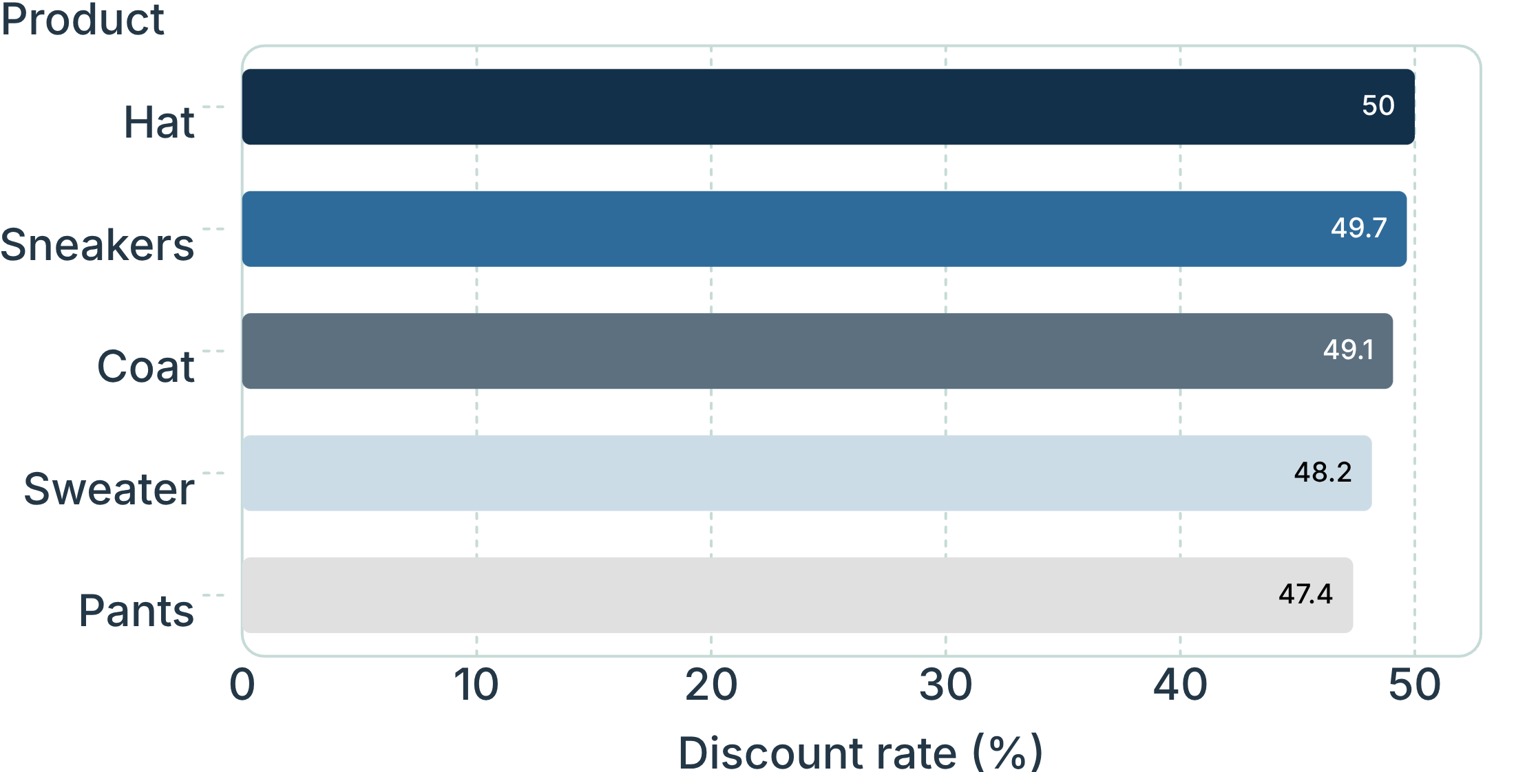
Discounting is a lever, but some products may be over-dependent on it
Promotion can coexist with strong basket value.
High-spending discount users show that promotion can coexist with strong basket value.
Review discount depth by product and test margin-aware targeting instead of broad markdowns.
Highest discount rates by product · percent

Slide 9

Turn existing loyalty into higher recurring value
1
Convert repeat buyers
Give loyal and returning customers a clear subscription reason.
2
Protect margin
Reserve deeper discounts for products with a measurable response.
3
Personalize campaigns
Lead with clothing, accessories, young adults, and express-shipping moments.
4
Merchandise proof
Spotlight top-rated products and category leaders.

Slide 10
Recommended next moves for the business
1
2
3
Test subscription value
Manage promotion by margin
Make performance weekly
Launch a subscription value test with exclusive benefits for loyal customers.
Build a margin-aware promotion dashboard for discount-dependent products.
Use the Power BI view as the shared weekly operating rhythm for category, age, shipping, and subscription performance.

